Slide 1
Building solutions with Dataverse for Teams
Speaker:
<FULLNAME>
Cloud Solution Architect
Notes:
Workshop Version: 1.4

Slide 2
Conditions and terms of use
© Microsoft Corporation. All rights reserved.
You may use these training materials solely for your personal internal reference and non-commercial purposes. You may not distribute, transmit, resell or otherwise make these training materials available to any other person or party without express permission from Microsoft Corporation. URL’s or other internet website references in the training materials may change without notice. Unless otherwise noted, any companies, organizations, domain names, e-mail addresses, people, places and events depicted in the training materials are for illustration only and are fictitious. No real association is intended or inferred. THESE TRAINING MATERIALS ARE PROVIDED “AS IS”; MICROSOFT MAKES NO WARRANTIES, EXPRESS OR IMPLIED IN THESE TRAINING MATERIALS¹

Slide 3

Introduction
Who am I?
%Instructor Name%
%Role in Microsoft%
%Area of expertise / about me%
Who are you?
Name, role
Experience with Power Platform, Microsoft 365
Expectations for this workshop
Instructor photo (if remote)

Slide 4
Logistics
Schedule
Start time: 09:00 AM UTC
Lunch break: 1:00 PM UTC
Additional information
Ask your questions
End time: 05:00 PM UTC
Coffee breaks on demand
%any other useful info: restroom locations, wi-fi credentials etc%

Slide 5





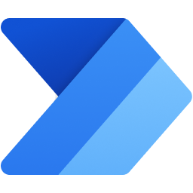
Agenda – Day 1
 | Dataverse for Teams Overview
 | Working with tables
 | Dataverse for Teams and Power Apps
 | Dataverse for Teams and Power Automate

Slide 6



Agenda – Day 2
 | Dataverse for Teams and Power Virtual Agents
 | Dataverse for Teams and Power BI
 | Dataverse for Teams administration

Slide 7
Dataverse for Teams overview
Module 0

Slide 8

Module overview
This module covers the following topics:
 | 1 | Introduction to low-code/no-code concept
 | 2 | Comparison of Dataverse and Dataverse for Teams
 | 3 | Why Dataverse for Teams?
 | 4 | Who can use Dataverse for Teams?
 | 5 | How to start with Dataverse for Teams?

Slide 9



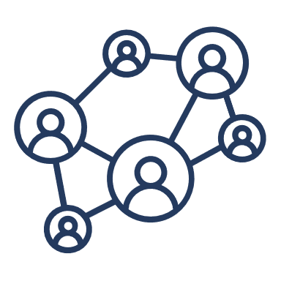
Business challenges
Optimize operations
Empower people
Processes need to modernize
Organizations need to be agile
Individuals and teams need to stay productive
Shortage of pro developers
Digital transformation
Transform products
Engage customers
Notes:
Discuss Business challenges:
Many individuals and teams have their own “productivity bottleneck”
Past year has shown, that org’s capability to quickly adapt is crucial
Workforce has new expectations
Pressure on IT resources
Shortage of pro developers
Solution development and support is slow, costly and needs people
Old solutions require modernization

Slide 10
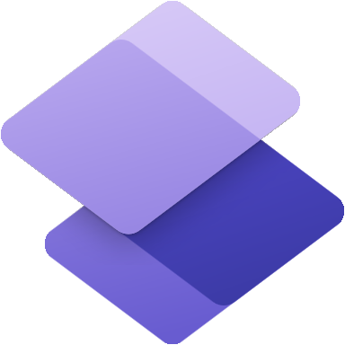

Introduction to low-code/no-code
Deliver digital solutions quickly and efficiently
User-friendly app building experience
Minimize administrative effort
Microsoft Power Platform
Notes:
Microsoft Power Platform for low-code/ no-code solutions
Help customers accelerate the development of applications that historically take longer to release and cost more money
The Power Platform design ensures the application is built in a way that will attract and retain users.
User Experience (UX) design focuses on the usability and accessibility of your application. The goal is to optimize the user experience
The User Interface (UI), design focuses on the app’s look and interacts with the users. Each screen, page, buttons and other visual elements you see while using an application is the User Interface of that application.
Microsoft Power Platform design increases usability, lower cost, faster development time = increase revenue
Administrative effort is minimized, if the platform/ecosystem is unified

Slide 11
Microsoft Teams Integration with Microsoft Power Platform
Microsoft Teams
Platform for teamwork
Chat, collaboration, meetings, calling, and app integrations for 145M+ daily active users, and more than 5B meeting minutes generated in a single day.
Microsoft Power Platform
Low-code/no-code business applications
Used by 97% of the Fortune 500 companies to accelerate internal app development and empower citizen developers to build custom line of business solutions.
Notes:
Teams integration with Microsoft Power Platform
Note: Power Pages are not supported in Dataverse for Teams.
Teams integration with Microsoft Power Platform has improved to let users build appa, automated workflows between apps and services, build bots and create reports without ever leaving the Teams interface:
As results
Remote work become easier and more productive.
Organization saves money
Increase speed of development
Broaden the scope of the people, who can participate in development and support
Improved processes
Teams integration with Microsoft Power Platform - Microsoft Teams | Microsoft Docs
Teams integration with Microsoft Power Platform https://docs.microsoft.com/en-us/microsoftteams/teams-power-platfom-integration

Slide 12
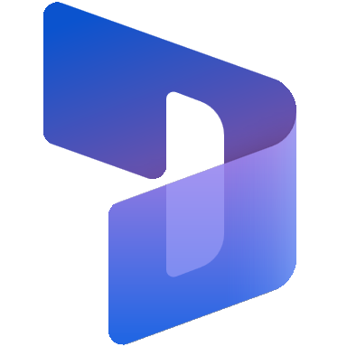


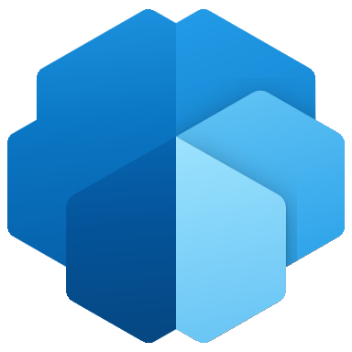



What is Dataverse?
Dataverse is a database of Power Platform (formerly Common Data Service)
Dataverse securely stores and manages data used by business apps
Custom data is stored within set of tables
Built–in features for security, automation, integration and analytics
Flows
Bots
Apps
Analytics
D365 Apps
Pages
Data integration
Custom data
Common Data Model
AI Builder
Data connections
Notes:
Dataverse lets you securely store and manage data that's used by business applications. Data within Dataverse is stored within a set of tables.
A table is a set of rows (formerly referred to as records) and columns (formerly referred to as fields/attributes). Each column in the table is designed to store a certain type of data, for example, name, age, salary, and so on. Dataverse includes a base set of standard tables that cover typical scenarios, but you can also create custom tables specific to your organization and populate them with data by using Power Query. App makers can then use Power Apps to build rich applications that use this data.
As part of Microsoft Power Platform, Dataverse requires no or little code to be written, so it can easily be used by everyone from knowledge workers to professional developers.
Knowing that it's built on Azure, organizations choosing Dataverse can be confident that it's globally available, compliant, scalable, and secure.
Dataverse empowers organizations to work with any type of data and any type of app and use the data within it to gain insights and drive business action.

Slide 13
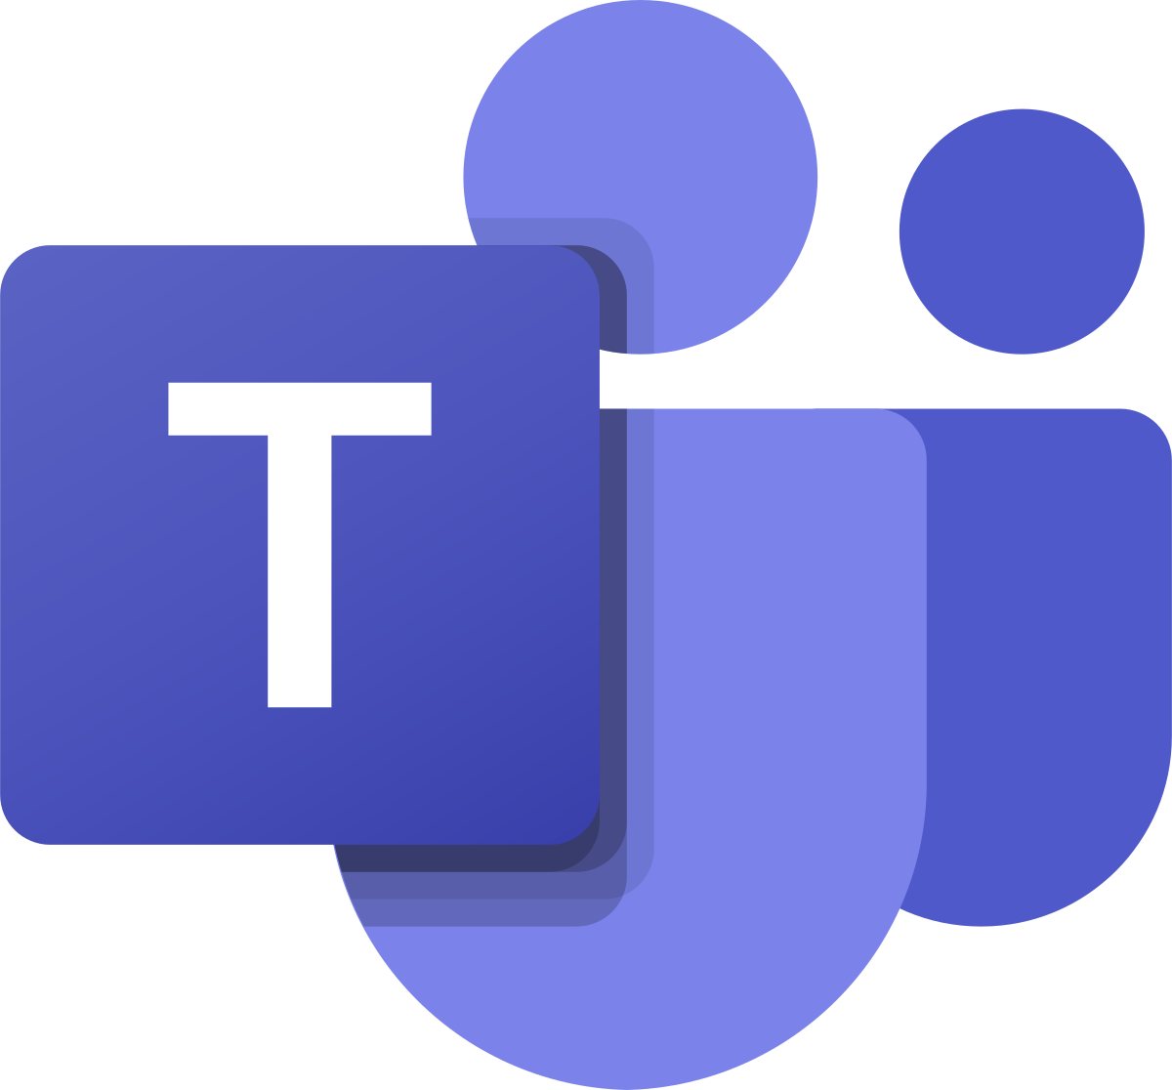
What is Dataverse for Teams?
A new built-in low-code data platform for Microsoft Teams
Subset of Dataverse capabilities
Allows building of apps, automation, chatbots within Microsoft Teams
Flows
Bots
Apps
Analytics
Data connections
Custom data
Notes:
Discuss that Dataverse for Teams
Help customers accelerate the development of applications that historically take longer to release and cost more money
Allows power users to
build Apps with Power Apps
Build automation with Power Automate
build chatbots with Power Virtual Agents
And allow rich analytics with Power BI
Database for Teams functionality is included in most existing Teams licenses.
With Dataverse for Teams, if the team is deleted, the Dataverse for Teams environment that was created will also be deleted. The Dataverse for Teams environment itself can be deleted from within the team by the team owner. A warning will be provided prior to allowing the deletion to go through, to ensure there are no accidental deletions.
Upgrade (scalability) to Dataverse (coming soon). It is in place upgrade.

Slide 14
What is a Dataverse for Teams Environment?
A container for the Dataverse for Teams data, apps, flows and bots
It is automatically created for the team when an app or a bot is created within it
Dataverse for Teams environment and its contents will be removed if the team expires or is deleted
Environment
Microsoft Confidential
Notes:
The environments can be controlled by the administrators from the Power Platform admin center
If the team is deleted, the Dataverse for Teams environment that was created will also be deleted. The Dataverse for Teams environment itself can be deleted from within the team by the team owner. A warning will be provided prior to allowing the deletion to go through, to ensure there are no accidental deletions.

Slide 15

Dataverse for Teams and Dataverse comparison
For use in Teams only |  | For building larger scale applications
Relational data storage within a Team |  | Larger datasets, data lake, offline data, data integrations
1 Dataverse for Teams environment per Team (max environments: 5 default + 1 per 20 users) |  | Unlimited number of environments
Up to 2 GB data storage per team |  | Up to 4 TB of data storage
Permissions inherited from the Team |  | Rich access control and auditing capabilities
Capacity add-ons are not available |  | Capacity add-ons available
Microsoft Confidential
Notes:
Discuss the differences between Dataverse for Teams and Dataverse
Should more instances be needed, consider deleting unused environments or upgrading environments to Dataverse. Customers with more than 200,000 eligible Microsoft 365 seats should contact their Microsoft representative.

Slide 16
Dataverse for Teams Upgrade
In-place upgrade is possible for Dataverse for Teams, in order to:
Use full Dataverse functionality
Increase storage capacity
Implement proper application lifecycle
No need to rebuild or redesign your solution
Dataverse for Teams
In-place upgrade
Dataverse
Microsoft Confidential
Notes:
One of the benefits of Dataverse for Teams is easy in-place upgrade that will not require architectural changes in your solution
Upgrade process https://docs.microsoft.com/en-us/power-platform/admin/about-teams-environment#upgrade-process
Dataverse for Teams environments won't be allowed to change types until the upgrade operation has been carried out on the environment. After the upgrade is complete, the Dataverse for Teams environment will have the full capabilities found in Dataverse.

Slide 17


Why Dataverse for Teams solutions?
Increase personal and team productivity
Innovations to support power users and pro developers
Embedded maker studio
Easily accessible relational database
Templates and pre-built solutions
Creators’ resources to identify scenario and start building
Developer skills are not a prerequisite
Anyone can bring ideas to life by building apps, automation, and chatbots
Microsoft Confidential
Notes:
No requirement to be a Pro developer to build solutions with Dataverse for Teams
Microsoft Power Platform enables anyone to bring ideas to life by building apps, automation, and chatbots
Few ideas which can help in productivity using Dataverse for Teams solution
Organizing Events
Customer support
Business Insight
Sales support
Employees’ productivity
Employees’ relations
Fun
Team collaboration and Teams coordination
Track Progress

Slide 18
Who can use Dataverse in Teams ?
Anyone with a Microsoft Teams license
Team owners and members can build apps, automation, and chat bots
Guest users in teams can discover and run apps in their team
Apps and bots can be shared with other teams
Microsoft Confidential
Notes:
Dataverse for Teams and Power Virtual Agents for Teams capabilities will be available as part of select Microsoft 365 subscriptions with Power Platform and Teams capabilities, excluding plans for US government environments (GCC, GCC High and DoD) and EDU A1 and SUB SKUs.
Team guests can access Dataverse for Teams apps, only if they are licensed or “bring their own” license (minimum required licensing is the same as for members). Guests can’t make, install, or edit apps.
Members and guests’ table permissions are discussed further in Module 1.
Sharing Apps and Bots with other teams is discussed in Module 2

Slide 19
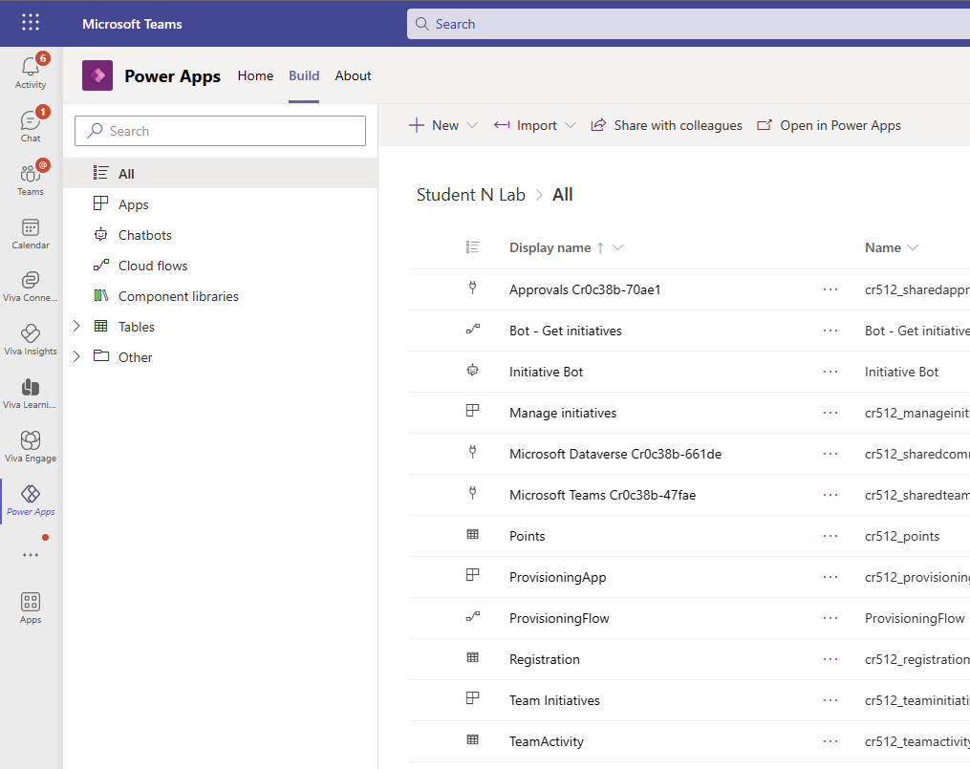
How to start with Dataverse for Teams?
Use Power Apps Teams app to work with Dataverse for Teams:
Provision a new Dataverse for Teams environment for Team
Control the contents of your Dataverse for Teams environment
Create and author your new apps, flows and chatbots (redirects to PVA app)
Navigate between Dataverse for Teams environments of multiple teams
Microsoft Confidential
Notes:
PVA is Power Virtual Agents
Explain that The Dataverse for Teams environment is automatically created for the selected team when you create an app or bot in Microsoft Teams for the first time or install a Power Apps app from the app catalog for the first time.
Dataverse for Teams environment are NOT created by default.
The Dataverse for Teams environment is used to store, manage, and share team-specific data, apps, and flows. Each team can have one environment, and all data, apps, bots, and flows created with the Power Apps app inside a team are available from that team's Dataverse for Teams database.
Demo - Refer to this module Appendix for what is required to demo to attendees.
(how to access teams, pin Power Apps, create an app, give the app a name. Explain that now a Dataverse for Teams environment is being created in few minutes).

Slide 20
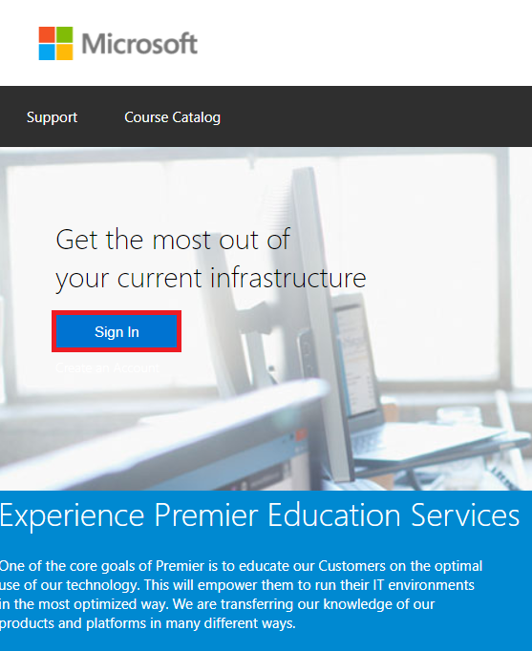

Access the Lab Environment
Access the demo tenant which the instructor built for you via: https://aka.ms/lod
2. Sign in using personal Microsoft Account
Ask instructor if you have any problems
Access to LOD labs will last for 90 days.
Microsoft Confidential
Notes:
This information is duplicated in Lab 0 intructions

Slide 21
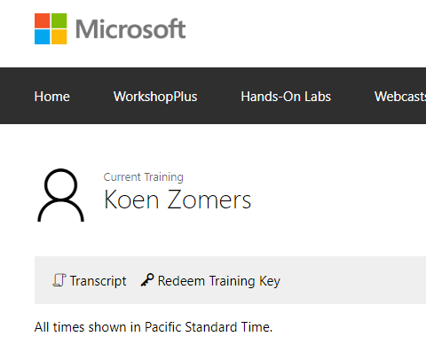
Access the lab environment – Redeem a key
https://aka.ms/lod
Go to WorkshopPlus -> My Training
Click on Redeem Training Key
Your training key
Student
XXXXXXX
Microsoft Confidential

Slide 22
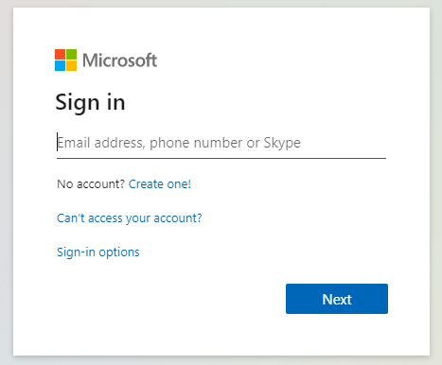
Connect to M365 tenant
Open your browser in Incognito/InPrivate mode and go to: https://office.com
Enter the credentials from your LoD resources tab
Refer to the lab guide
The lab tenant will last for 90 days
Microsoft Confidential
Notes:
Please use private browser - New In private window

Slide 23

Lab 0: Prerequisites
Objectives
Access the lab tenant using credentials provided by your instructor
Create a team
Never upload your organization data to the lab tenant.
Notes:
Refer to lab 0-0 instructions
##########

Slide 24
Appendix

Slide 25
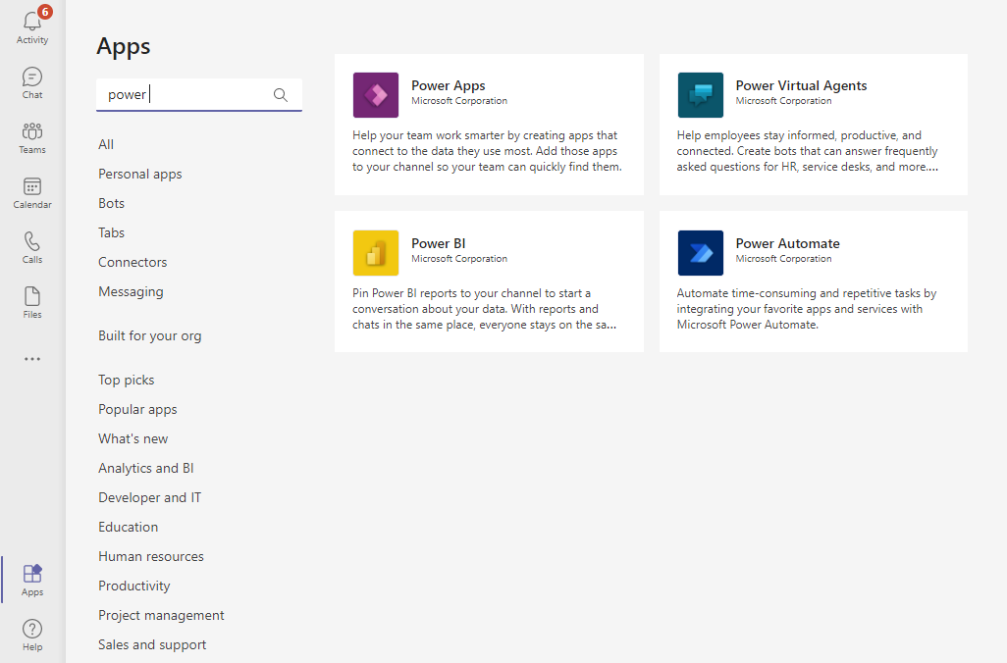
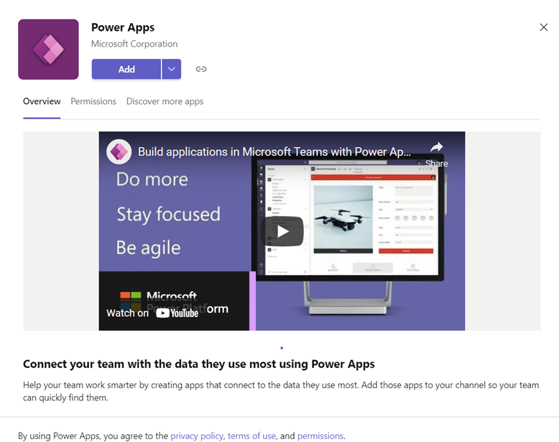
How to install Power Apps app in Teams?
Power Platform related applications are available in Teams Apps catalog (by default)
Administrator can control access to Power Platform apps (and shared apps) if needed
Microsoft Confidential
Notes:
Show the slides in live demo
Power Platform related applications are available in Teams Apps catalog (by default)
Administrator can allow certain power platform applications, block certain power platform application, or block all Power Platform application.
How to control Power Platform app availability is covered in admin section.

Slide 26
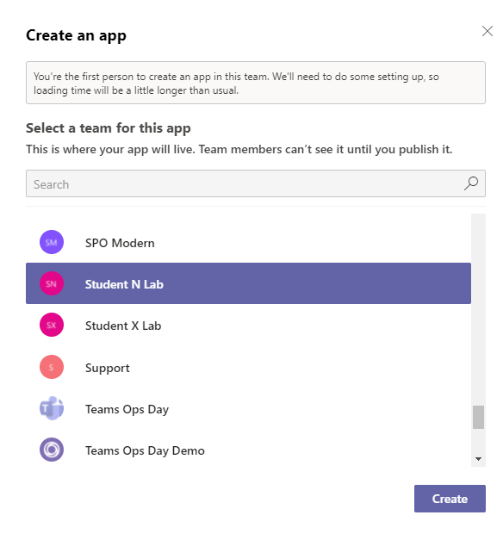
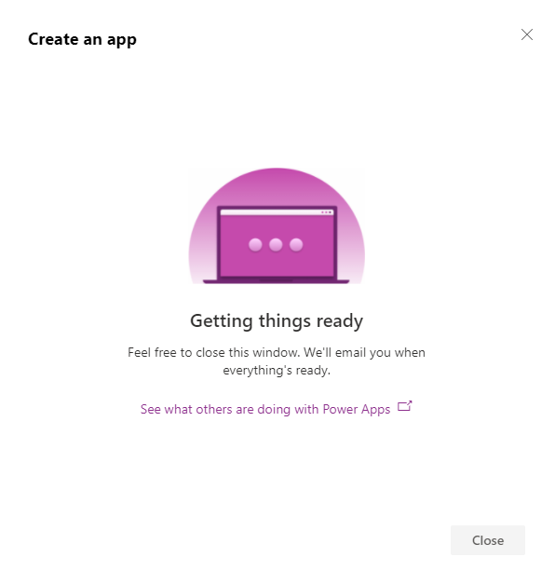
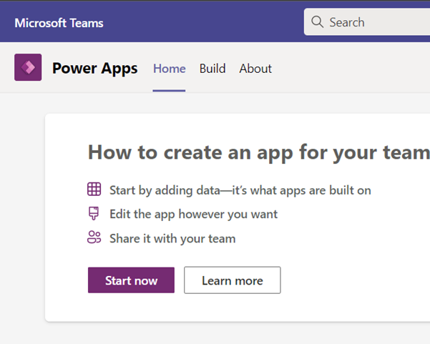
How to provision Dataverse for Teams environment?
If you don’t have Dataverse for Teams environment provisioned in a Team:
The first user, who will click Create, will start Dataverse for Teams provisioning.
It can take a few minutes to set things up.
Microsoft Confidential
Notes:
Show it as a live demo

Slide 27
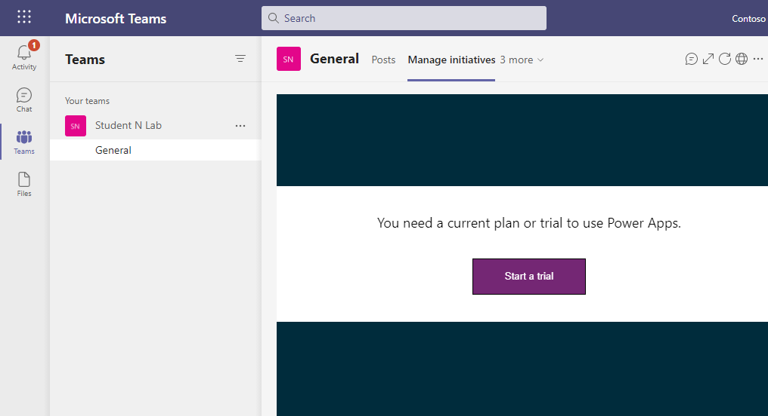
Team guest access
Team guest needs license to run Power Apps:
If the guest is from another M365 tenant and has license, then BYOL works seamlessly
If the guest doesn’t have license, then it needs to be assigned, or guest may start trial
Guests can't make or edit apps
Power App is not displayed, because the guest is not licensed
Microsoft Confidential
Notes:
Table permissions are discussed further in Module 2
Guests can't make, install, or edit apps

Slide 28



Dataverse for Teams – what’s under the hood?
Both Dataverse and Dataverse For Teams are based on:
Azure SQL Database
Azure Storage
Azure Cosmos Database
Microsoft Confidential
Notes:
Please discuss this slide if attendees are IT professionals, it is important for them to know that both Dataverse and Dataverse for Teams are based on same type of database.
Database types are mentioned in the slide.
Microsoft Azure SQL Database (formerly SQL Azure, SQL Server Data Services, SQL Services, and Windows Azure SQL Database) is a managed cloud database provided as part of Microsoft Azure.
The Azure Storage platform is Microsoft's cloud storage solution for modern data storage scenarios.
Azure Cosmos DB is Microsoft's globally distributed multi-model database service.

Slide 29
Questions?

